Slide 1


Zoom session 2 COEN 352
Please check your mic and speaker settings.
Stop sync cloud apps such as Dropbox, Onedrive, Box, etc.
Thanks for your collaboration.

Slide 2

Tutorial 2
COEN 352: Data structure and algorithm
TA: Mohammed A. Shehab

Slide 3
Outlines
Data Structure.
Fundamentals of the Analysis of Algorithm Efficiency.
Frequency Count Of Algorithms.
Asymptotic Notations.

Slide 4
Data Structure

Slide 5
What is a Data Structure?
A container that stores data in a specific layout.
This “layout” allows a data structure to be efficient in some operations and inefficient in others.
Your goal is to understand data structures so that you can pick the data structure that’s most optimal for the problem at hand.

Slide 6
Commonly used Data Structures
Arrays
Stacks
Queues
Linked Lists
Trees
Graphs

Slide 7
Fundamentals of the Analysis of Algorithm Efficiency

Slide 8
The general framework for analyzing the efficiency of algorithms
Time efficiency, also called time complexity, indicates how fast an algorithm in question runs.
Space efficiency, also called space complexity, refers to the amount of memory units required by the algorithm in addition to the space needed for its input and output.
Now the amount of extra space required by an algorithm is typically not of as much concern.
The time issue has not diminished quite to the same extent, however.

Slide 9
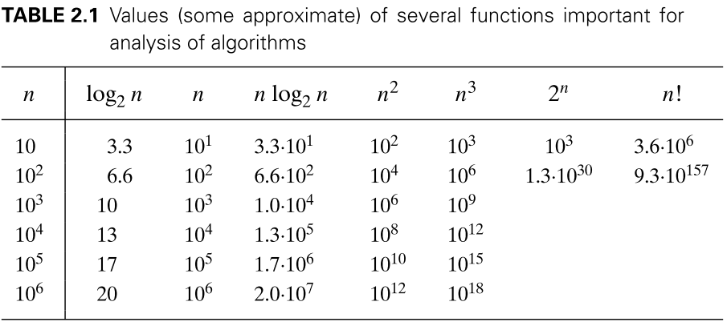
Orders of Growth

Slide 10
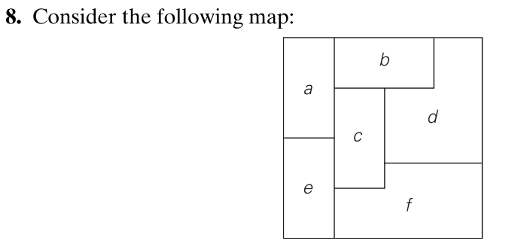
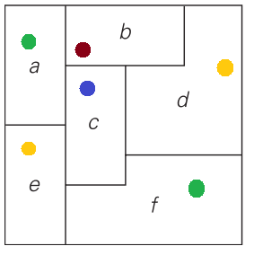
NP-complete example
Read the file Note2.pdf, if you want to see the proof of minimum number of colors

Slide 11
Frequency Count Of Algorithms

Slide 12
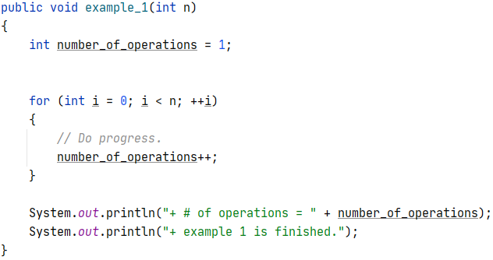

Slide 13
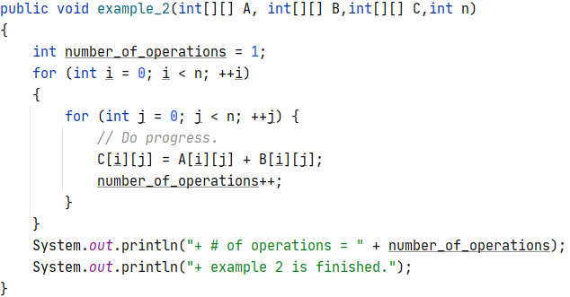

Slide 14
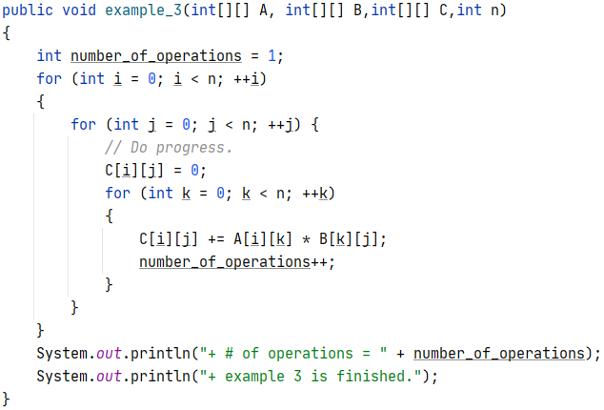

Slide 15
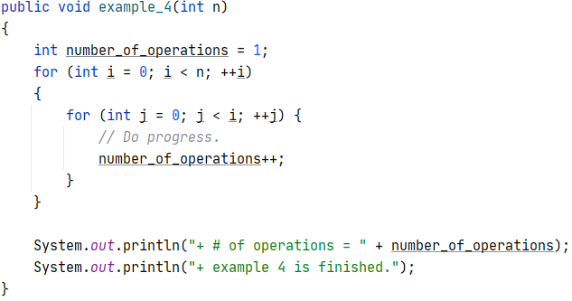

Slide 16
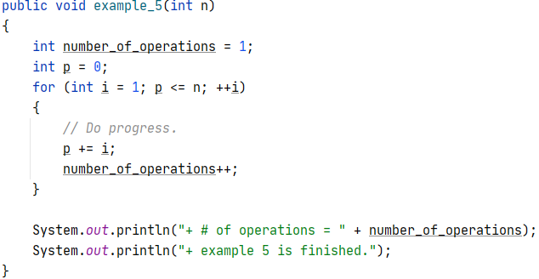

Slide 17
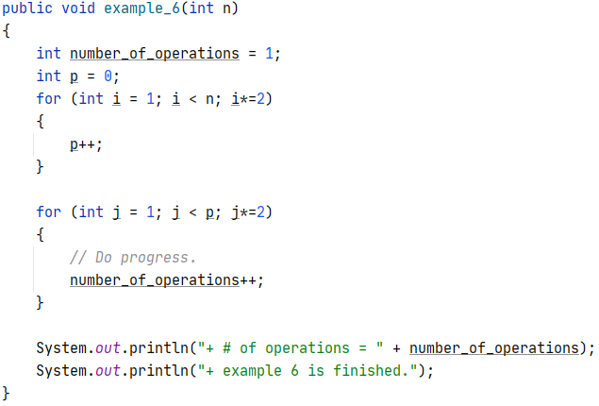

Slide 18
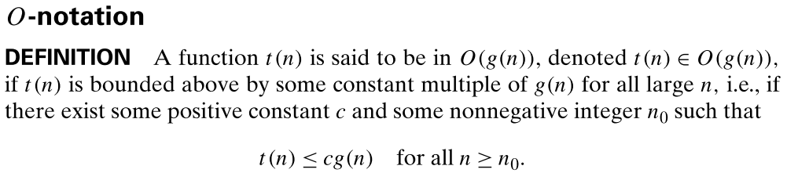
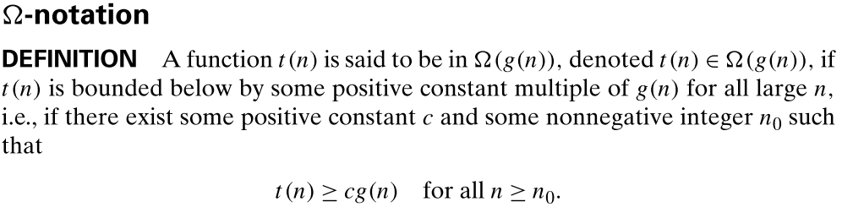
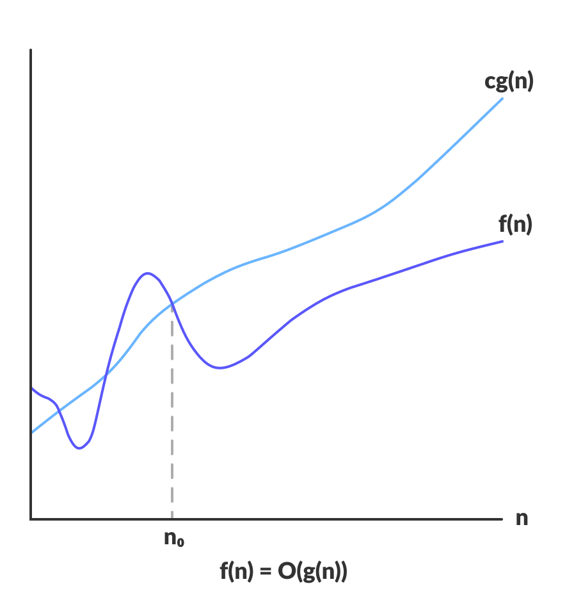
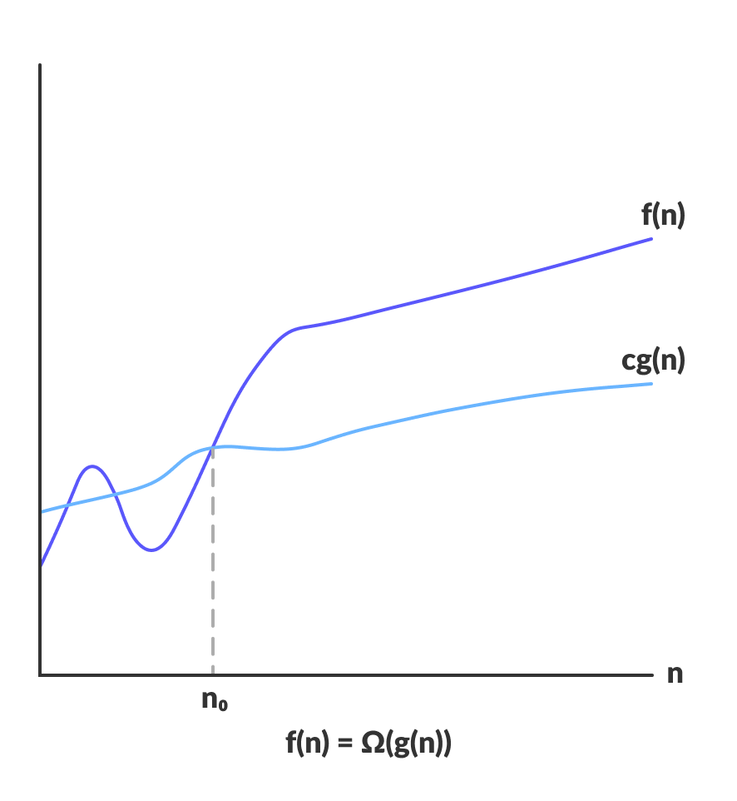
Asymptotic Notations

Slide 19
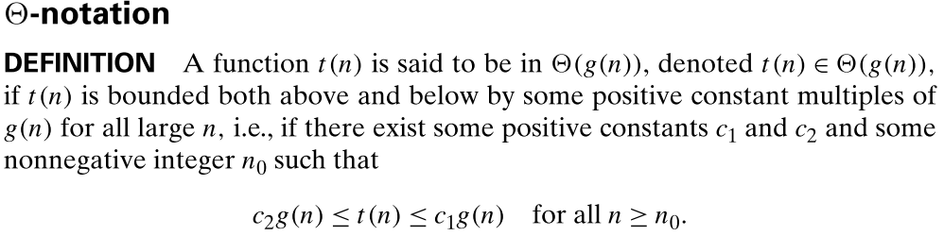
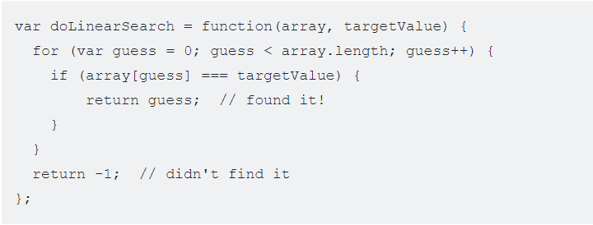
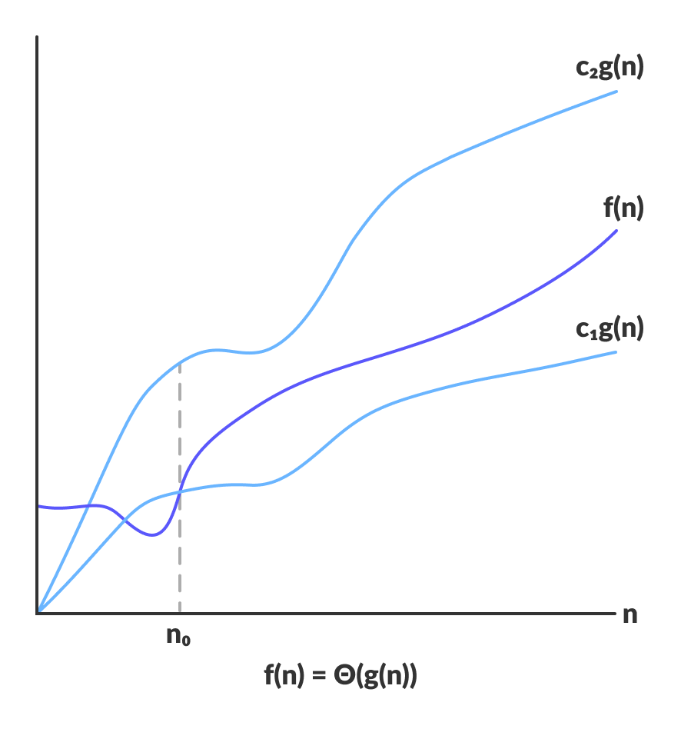
Asymptotic Notations II
Example
n + 1
n
* 1
n
* 1
1
f(n) = 3n + 2
To see the full proof, read pdf file name The proof of f(n)=3n+2.pdf

